Slide 1


Placing You At The
Of Good Food
Wherever You Are!

Slide 2
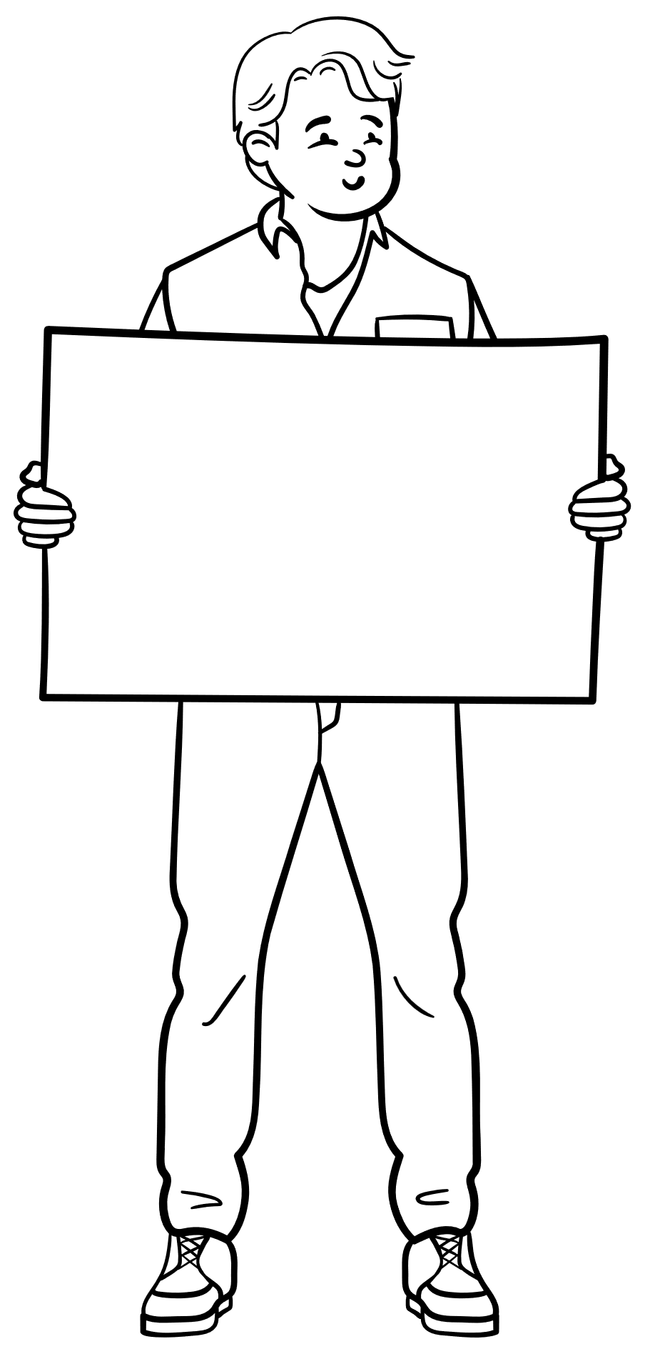


The Problem

Slide 3



The Solution

Slide 4
The Concept
An application that makes finding good quality food easy.
Build a list of your favourite or soon to be favourite restaurants.
Locals/Tourists (USER STORY)

Slide 5
The Process
Technologies
Task Breakdown
JavaScript
HTML
CSS
Adiba: CSS, Presentation, Readme
Maarteje: JavaScript
Connie: HTML, Readme
Mohamed: CSS, Presentation

Slide 6
The Process
Challenges
Successes
Finding a suitable API
Merging Conflicts
JS challengers with the buttons value of buttons showing on map)
Finding a suitable API
Merging Conflicts

Slide 7
The Demonstration
LINK

Slide 8
Future Developments
Planner (e.g. datenights)
Merging Conflicts

Slide 9
Links
Deployed Page:
GitHub Repo: https://github.com/connielau123/web-application-project-1

